Slide 1
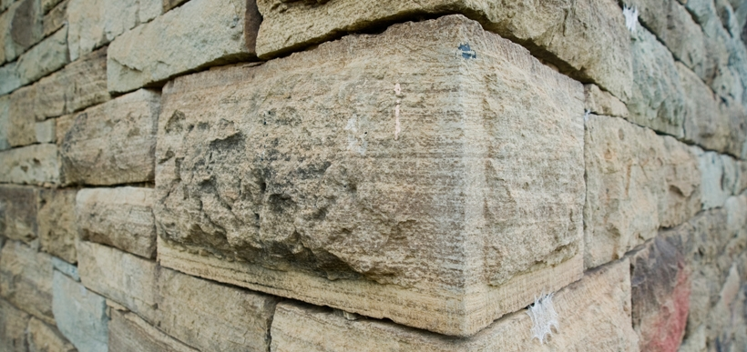
The stone that was rejected
WEEKLY PEBBLE
27th Sunday of Ordinary Time

Slide 2
In the name of the Father
And of the Son
And of the Holy Spirit
Amen

Slide 3
A reading
from
THE GOSPEL
According to
MATTHEW

Slide 4
It was the stone rejected by the builders that became the cornerstone.
This was the Lord’s doing and it is wonderful to see.
The kingdom of God will be given to a people who will produce its fruit.’
Matthew 21:33-43

Slide 5
The Gospel of the Lord
ALL: Praise to you Lord Jesus Christ.

Slide 6
Scripture Sound Bite
‘Cornerstone’
Matthew 21:33-43
Jesus often uses the careers of every day people to help explain his teachings.
Builders know that you need to choose the strongest, straightest stone to put in a corner to build the strongest walls possible. Why would they choose an imperfect stone for this vital job?
Despite our imperfections, we too have the potential to support the lives of others.

Slide 7
Mental health is a universal human right

Slide 8
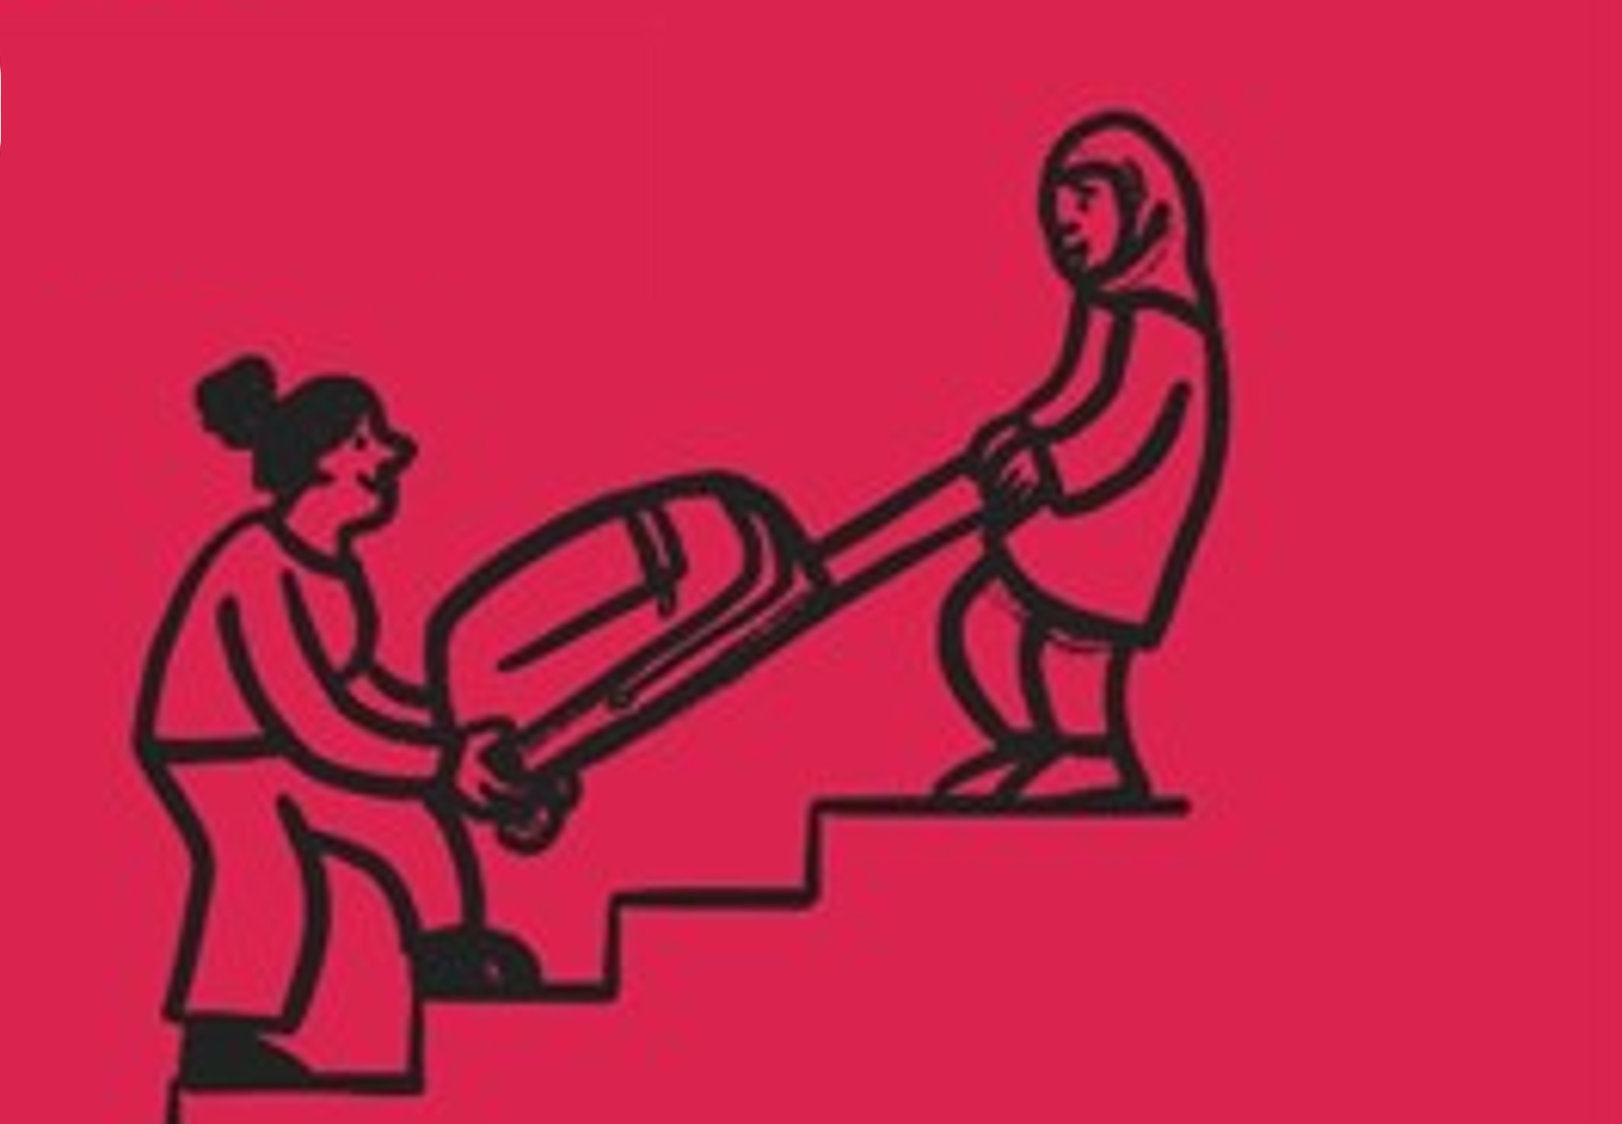
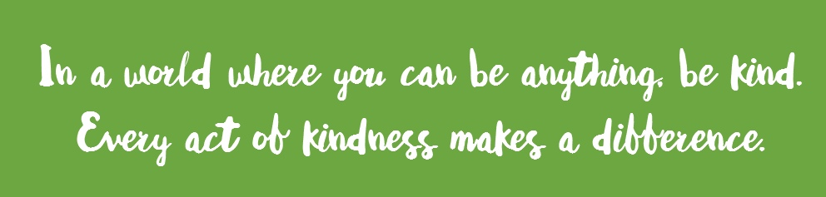
Actions for Happiness: GIVING
The smallest act of kindness is worth more than the greatest intention.
HELPING one person might not change the whole world,
but it could change the world for ONE PERSON
Support a charity, cause or campaign you really care about.

Slide 9
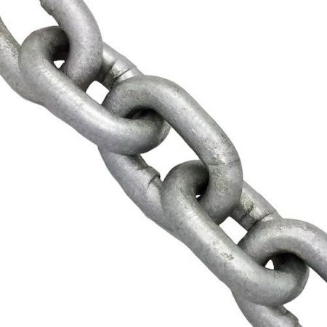
Prayer
God has created me to do him some definite service.
I am a link in a chain, a bond of connection between persons.
AMEN

Slide 10
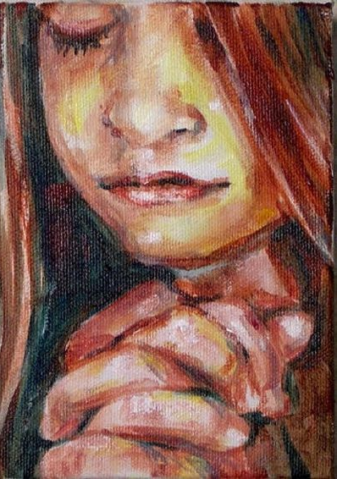
Open my ears
that I may hear
Open my eyes
that I may see
Open my heart
to welcome your transforming presence
In all I do and say today
Amen
Let us pray…

Slide 11
In the name of the Father
And of the Son
And of the Holy Spirit
Amen

Slide 12
GREAT DREAM: 10 Keys to Happier Living
 | GIVING Do things for others |  | DIRECTION Have goals to look forward to
 | RELATING Connect with people |  | RESILIENCE Find ways to bounce back
 | EXERCISING Take care of your body |  | EMOTION Look for what’s good
 | AWARENESS Live life mindfully |  | ACCEPTANCE Be comfortable with who you are
 | TRYING OUT Keep learning new things |  | MEANING Be part of something bigger
BE KIND TO YOUR MIND

Slide 13
WEEKLY PEBBLE is based on the theme of each Sunday’s Gospel.
It can be used to inspire personal reflection or collective worship.
The slides are designed to make them easy to adapt for children of any age and adults.
Each pebble includes free wellbeing activities based on ideas from actionforhappiness.org.
For more prayer activities and training resources on Catholic ethos
visit https://www.stjohnthebaptist-cmat.org.uk/chaplaincy
or contact our Lay Chaplain Alex Savage
Email: chaplaincy@ndhs.org.uk Twitter: @ndhs_chaplain
WEEKLY PEBBLE
St John the Baptist Trust

