Slide 1
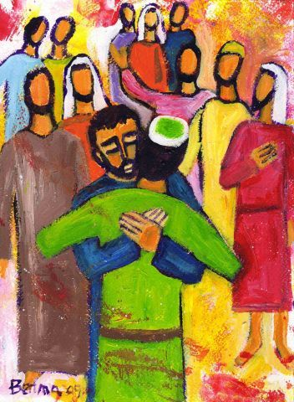
Forgiveness
WEEKLY PEBBLE
24th Sunday of Ordinary Time

Slide 2
In the name of the Father
And of the Son
And of the Holy Spirit
Amen

Slide 3
A reading
from
THE GOSPEL
According to
MATTHEW

Slide 4
Peter went up to Jesus and said, ‘Lord, how often must I forgive my brother if he wrongs me? As often as seven times?’
Jesus answered, ‘Not seven, but seventy-seven times.
Excerpt from
Matthew 18:21-35

Slide 5
The Gospel of the Lord
ALL: Praise to you Lord Jesus Christ.

Slide 6
Scripture Sound Bite
‘how often must I forgive…?’
Matthew 18:21-35
We have times in our lives when we make mistakes and need to ask for forgiveness.
However, it is often the most difficult Gospel Value for us to give to others.
Being able to forgive others is an ability that we need to develop every day.
Often the person that find it most difficult to forgive is ourselves.

Slide 7
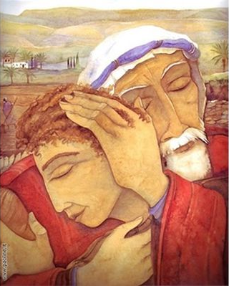
“
When you forgive, you in no way change the past –
but you sure do change the future.
- Bernard Meltzer
“
BRIGHT IDEA
Notes:
6/9
23rd Sunday in Ordinary Time
Gospel
Matthew 18:15-20

Slide 9
“Hosanna in the highest!” Matthew 21:1-11
UN World Day of Peace 21/09
What’s the goal here?
To have a day of non-violence throughout the world.
Why?
COVID-19 has taught us that what happens in one part of the planet can impact people everywhere.
DARE TO CARE
What do we need to do?
We need to learn that we are not each other’s enemies.
By working together we can resolve issues such as climate change and poverty.
Notes:
Gospel
John 10:1-10
I am the gate of the sheepfold
Jesus said:
‘I tell you most solemnly, anyone who does not enter the sheepfold through the gate, but gets in some other way is a thief and a brigand. The one who enters through the gate is the shepherd of the flock; the gatekeeper lets him in, the sheep hear his voice, one by one he calls his own sheep and leads them out. When he has brought out his flock, he goes ahead of them, and the sheep follow because they know his voice. They never follow a stranger but run away from him: they do not recognise the voice of strangers.’
Jesus told them this parable but they failed to understand what he meant by telling it to them.
So Jesus spoke to them again:
I am the gate of the sheepfold.
Anyone who enters through me will be safe:
he will go freely in and out
and be sure of finding pasture.
I have come
so that they may have life and have it to the full.’

Slide 10
Actions for Happiness: Relating
Connect with people
Feeling connected to other people is at the heart of happiness – theirs and ours.
When we’re together,
everything’s better.

Slide 11
The SDGs are targets that the UN has set all countries to work together to achieve by 2030.
21/09 is the UN’s International Day of Peace.

Slide 12
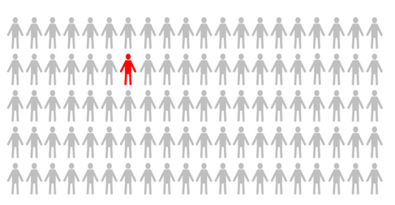
1 in 100 PEOPLE
In 2019 the number of people fleeing war, persecution and conflict exceeded 79.5 million, the highest level ever recorded.
This means that more than 1 in every 100 people on our planet has had to leave their home to find safety due to conflict.

Slide 14
“Hosanna in the highest!” Matthew 21:1-11
UN World Day of Peace 21/09
What’s the goal here?
To have a day of non-violence throughout the world.
Why?
COVID-19 has taught us that what happens in one part of the planet can impact people everywhere.
DARE TO CARE
What do we need to do?
We need to learn that we are not each other’s enemies.
By working together we can resolve issues such as climate change and poverty.
Notes:
Gospel
John 10:1-10
I am the gate of the sheepfold
Jesus said:
‘I tell you most solemnly, anyone who does not enter the sheepfold through the gate, but gets in some other way is a thief and a brigand. The one who enters through the gate is the shepherd of the flock; the gatekeeper lets him in, the sheep hear his voice, one by one he calls his own sheep and leads them out. When he has brought out his flock, he goes ahead of them, and the sheep follow because they know his voice. They never follow a stranger but run away from him: they do not recognise the voice of strangers.’
Jesus told them this parable but they failed to understand what he meant by telling it to them.
So Jesus spoke to them again:
I am the gate of the sheepfold.
Anyone who enters through me will be safe:
he will go freely in and out
and be sure of finding pasture.
I have come
so that they may have life and have it to the full.’

Slide 15
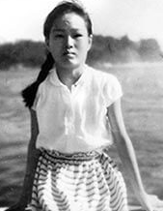
Cranes of Peace
Sadako Sasaki was a 12 year old girl who contracted Leukaemia after being exposed to the effects of the Atomic Bomb in Hiroshima.
She was inspired by a Japanese legend that if someone folded 1000 cranes, their wish would be granted.
Sadako wished to become well and to go home. She managed to fold over 1000 cranes, but sadly she died.
However, her story lived on and she became a symbol of hope and peace all around the world.

Slide 16
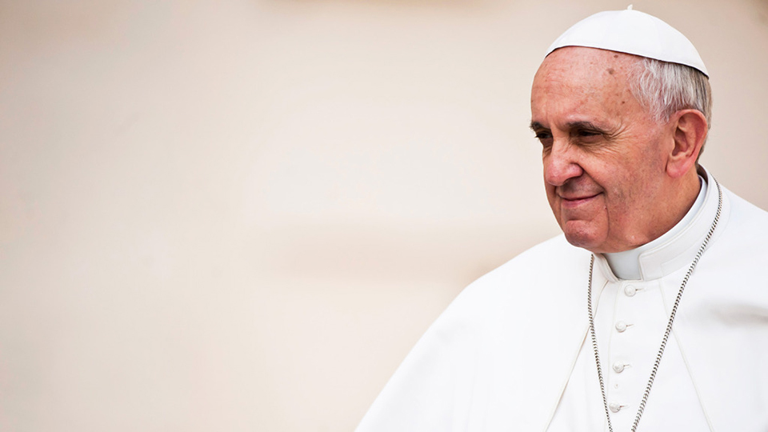
‘Your young hearts want to build a better world.
Do not be bystanders in life. Get involved!’
POPE FRANCIS

Slide 17
Prayer
Help us to discover our true value and to find ways to invest more time and effort into caring for ourselves.
Help us to focus on adding value to the lives of those around us so that we can live together in peace.
Amen

Slide 18
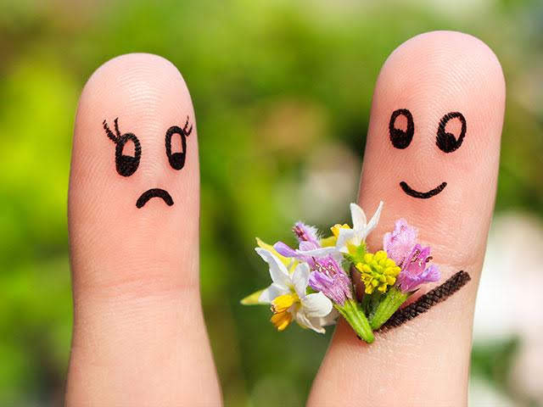
Prayer
We pray for the gift of forgiveness.
Help us to follow Jesus’ example to forgive those who upset us.
Help us to also forgive ourselves
AMEN

Slide 19
In the name of the Father
And of the Son
And of the Holy Spirit
Amen

Slide 20
GREAT DREAM: 10 Keys to Happier Living
 | GIVING Do things for others |  | DIRECTION Have goals to look forward to
 | RELATING Connect with people |  | RESILIENCE Find ways to bounce back
 | EXERCISING Take care of your body |  | EMOTION Look for what’s good
 | AWARENESS Live life mindfully |  | ACCEPTANCE Be comfortable with who you are
 | TRYING OUT Keep learning new things |  | MEANING Be part of something bigger
BE KIND TO YOUR MIND

Slide 21
WEEKLY PEBBLE is based on the theme of each Sunday’s Gospel.
It can be used to inspire personal reflection or collective worship.
The slides are designed to make them easy to adapt for children of any age and adults.
Each pebble includes free wellbeing activities based on ideas from actionforhappiness.org.
For more prayer activities and training resources on Catholic ethos
visit https://www.stjohnthebaptist-cmat.org.uk/chaplaincy
or contact our Lay Chaplain Alex Savage
Email: chaplaincy@ndhs.org.uk Twitter: @ndhs_chaplain
WEEKLY PEBBLE
St John the Baptist Trust

